Slide 1

Compiler Design
Preet Kanwal
Department of Computer Science & Engineering

Slide 2

Compiler Design
Building a Mini Compiler - Expression Evaluation
Preet Kanwal
Department of Computer Science & Engineering

Slide 3
Compiler Design
Implementation tasks
Updating the symbol table with values, line number and scope.
Expression evaluations. In case the input file has statements like a=10, b=20, c= a+b then your code must be able to update in the symbol table, value of c=30.
The code needs to take care of checks for variables that haven’t been declared and mismatched type variables in expressions. Display appropriate error message.

Slide 4
Compiler Design
Expected Results
Sample Input:
int main()
{
int a=5;
float b=4.6;
double c=6.9845;
char d="c";
a=2;
int b;
}
Output
Variable b already declared
Error :b at 8
Valid syntax
Name size type lineno scope value
a 2 2 7 1 2
b 4 3 4 1 4.6
c 4 3 5 1 6.9845
d 1 1 6 1 "c"

Slide 5
Compiler Design
Expected Results
Sample Input:
int main()
{
float x;
int y;
x = 3.4;
y = 45.4;
if(5>6)
{
x=4.5;
}
else
{
int z=5*6+5;
}
}
Output
Mismatch type
Error :45.4 at 6
Valid syntax
Name size type lineno scope value
x 4 3 9 1 4.5
y 2 2 6 1 45.4
z 2 2 13 2 35

Slide 6
Compiler Design
Expected Results
Sample Input:
int main()
{
int a=5;
b=3;
float c=4.5;
c=6.5;
double d=5.44;
double e=d+9.0-4.0/2.0;
}
Output
Variable b not declared
Error :b at 4
Valid syntax
Name size type lineno scope value
a 2 2 3 1 5
c 4 3 6 1 6.5
d 4 3 7 1 5.44
e 4 3 8 1 12.440000

Slide 7
Compiler Design
Mini-Compiler
Symbol table implementation: yacc file
Updating of the value and line number of a variable can happen during assignment or during expression evaluation.
Variable not declared can be checked when a variable is being assigned but isn’t in the symbol table.
//find type of T_ID for type checking
ASSGN : T_ID '=' EXPR {
/*
Check if variable is declared in the table
insert value
*/
}
;

Slide 8
Compiler Design
Mini-Compiler
DECLR : TYPE LISTVAR
LISTVAR : LISTVAR ',' VAR
| VAR
;
VAR: T_ID '=' EXPR {
/*
check if symbol is in table
if it is then error for redeclared variable
else make entry and insert into table
insert value coming from EXPR
revert variables to default values:value,type
*/
}
| T_ID {
/*
check if symbol is in table
if it is then error for redeclared variable
else make entry and insert into table
revert variables to default values:value,type
*/
}

Slide 9
Compiler Design
Mini-Compiler
Expression Evaluation implementation: yacc file
Expression grammar can extend to multiple rules, to keep track of the value you need to perform the calculation and pass it to to the rule.
It is very similar to a tree structure passing the value all the way up to the root.
Let’s take an example: a=10 b=5 c=a+b
Let the grammar be: ASSGN: T_ID ‘=’ EXPR EXPR:E E: E ‘+’ T | T T: T_NUM | T_ID

Slide 10
Compiler Design
Mini-Compiler
Important points:
You will have to create helper functions for the symbol table.(example: extracting value from name)
You will also have to keep track of certain variables during expression evaluation.(type, value, etc)
Take care of mismatch type using the above variables.

Slide 11
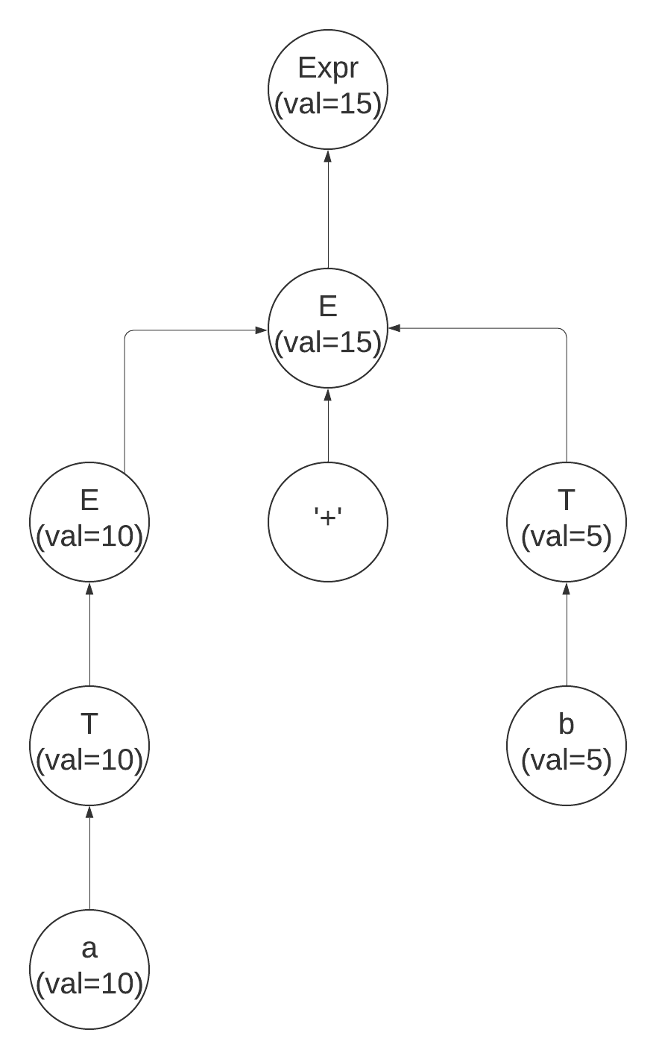
Compiler Design
Mini-Compiler
Here we see how the values travel from the variables a and b all the way to the expr grammar and from there we can just update the new value to c, which matches token T_ID To do this in YACC we need to use the $$,$1 notations to hold the semantic value
Ex: T : T_ID {$$=$1}
Here it means the value of token 1($1) is stored in T($$).

Slide 12
Compiler Design
Mini-Compiler
So our grammar would look like this
ASSGN: T_ID ‘=’ EXPR { update($1,$3)} //update(name,value)
EXPR: E {$$=$1}
E: E ‘+’ T {$$=$1+$3}
| T {$$=$1}
T: T_NUM {$$=$1}
| T_ID {$$=$1}
Note: The calculation may not be the same, if YYSTYPE is defined as char *, then you need to convert the string to int/float do the calculation and convert it back.

Slide 13
Compiler Design
Mini-Compiler
Scope tracking can be implemented in different ways, one way could be to have a variable keeping track of the block you are in.
//increment and decrement at particular points in the grammar to keep track of the scope.
MAIN : TYPE T_MAIN '(' EMPTY_LISTVAR ')' '{' STMT '}';
BLOCK : '{' STMT '}';

Slide 14
THANK YOU
Preet Kanwal
Department of Computer Science & Engineering
preetkanwal@pes.edu

